Slide 1
RELY Framework for Quality Assurance of S/4HANA Transformation Programs
March 2025

Slide 2
LTIMindtree SAP Quality Assurance Capability

Slide 3




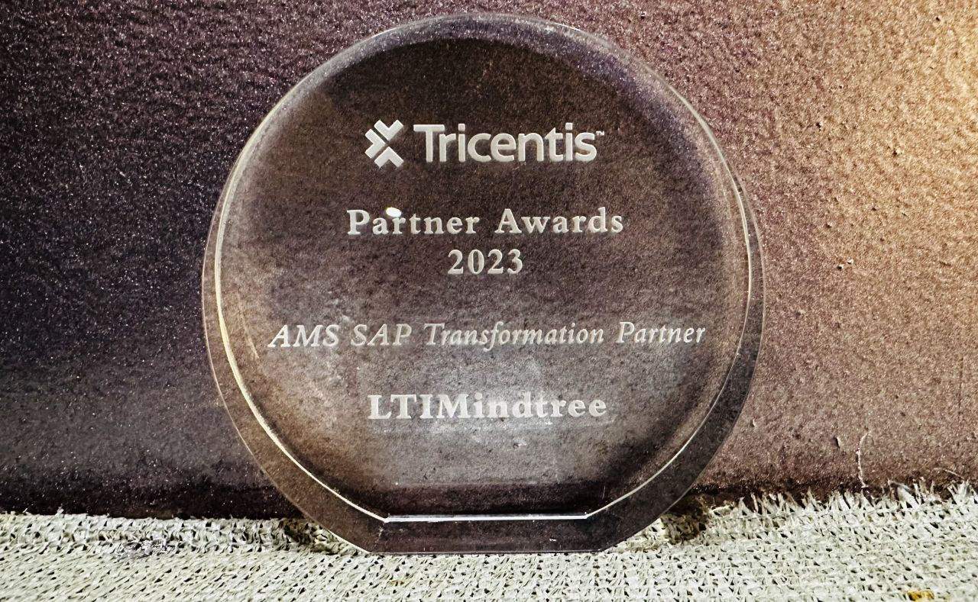









Our SAP Quality Assurance Practice
1,000+
300+
60+
15+
SAP Testing Resources
SAP Certified Experts
Active Clients
Test Accelerators
Values Delivered
Leaders Quadrant in Overall Testing Capability, 2020
Enterprise Quality Assurance(QA) Services PEAK Matrix Assessment 2022 - Star Performers
LEADER in Continuous testing
Test Assessment
QA Transformation
Managed &Co-Managed Testing
PoC, Tool Set Up
QCoE Set Up
Test Management
Test Automation
Cloud Migration
‘Expert’ in Mobile Application Testing Services
LTIM Accelerator- Rely Platform
‘Leader’ in Continuous Testing in US, UK, Nordics
Canvas Insights & Analyzer
Automation Frameworks
SAP Transformation Partner of the Year
2023 by Tricentis.
Test Assets Jukebox
BPAC Reporting
Service Offerings
SAP Validation Centre of Excellence
S/4HANA Greenfield Implementation Services
Cloud Migration Validation Services
Component Based Test Approach
Performance Validation Services
S/4HANA Brownfield Implementation Services
S/4HANA Upgrade Validation Services
Agile / Scrum Validation Approach
Data Migration Validation Services
Testing Tools License Resell
Our Partnerships for Testing Solutions

Slide 4
Our Quality Assurance Service Offerings
SAP Validation Centre of Excellence
Agile / Scrum Validation Approach
Functional Validation
Mobile & API Validation
S/4HANA Brownfield Implementation Services
Component Based Test Approach
S/4HANA Greenfield Implementation Services
Data Migration Validation Services
Non-Functional Validations
Data Migration Validations
S/4HANA Upgrade Validation Services
Performance Validation Services
Cloud Migration Validation Services
Testing Tools License Resell

Slide 5











Key challenges impacting the speed of SAP Transformation Programs
Challenges
E2E business process coverage in the to-be solution
Tool
Test coverage of business process variations and negative testing
Data readiness across testing environments
Tool
Challenges in UAT Planning and Execution
Performance, security and site specific (localized)
Unavailability of interface and infrastructure for testing
Duplication of QA effort across program phases
Lack of real time reporting for the PMO and executive board
Tool
Best Practices
Efficient test data management
Process standardization
ETE testing and defect management
Effective testing and reusability
Test data automation
Quality gates and KPIs
Test
Coverage
ETE process testing
Test
Automation
Test Governance
Traceability matrix
Performance monitoring
Governance model

Slide 6
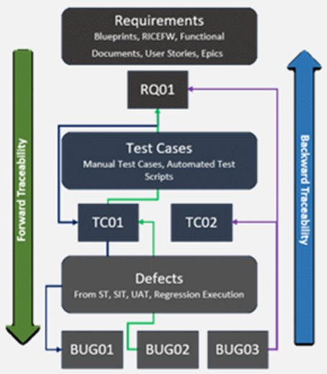
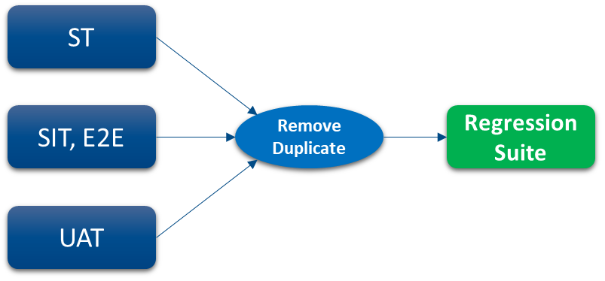
Comprehensive Test Coverage
End to end test case traceability from Requirements to Execution. Gap analysis to identify missing coverage. Update Test Scripts & Regression suite
Requirement Traceability
Gap Analysis
Remove Redundancy
Remediate Test Cases
Missing Coverage
Design new & remediate Existing Test Cases
Process to be followed
Create End to End work flows
System Changes – Weekly, Monthly, Minor, Major
Analyze Testing Artefacts by going through the requirements, test cases and logged defects. Validate & update Forward & backward traceability in the test management tool to ensure the requirement coverage.
Based on the requirement traceability matrix, list down the
Requirements with no or low test coverage
Defects with no test case coverage
Analyze the frequency of test case update based on the number of system changes
While consolidating & identifying the test cases to create a centralized regression suite, remove the duplicate test cases coming from ST, SIT & UAT packs to have an optimized repository.
Create additional test cases based on the Gap Analysis
Update the existing test cases to include missing requirements, steps, test data details
Create End to End business process scenarios
Description
Notes:
PT need to be added , dedicated slide.
The Worksoft Process Intelligence dashboard uses AI and ML to bring together multi-source, multi-variant data, offering a 360-degree of your end-to-end processes

Slide 7




Our First Time Right Approach to achieve maximum automation goal
Enhanced Coverage
Technology Adoption & Standardization
Strategic Automation Planning to minimizing program risks
Seamless API Automation to ensure continuous testing in incomplete environments and E2E automation
Increased In-sprint & Regression automation coverage
Quicker product feedback, review and implementation
AUTOMATION
FIRST
UNIFIED AUTOMATION
Technology agnostic & agile enabled model
Aligned with customer frameworks
Unified framework for SAP & non-SAP applications
1
2
Autonomous Automation
LIFECYCLE AUTOMATION
COGNITIVE AUTOMATION
Visual AI with Applitools enabled verifications with automation scripts for robust execution and low maintenance efforts
AI routines and a patented object framework to create and maintain reliable scripts & bots
AI and ML powered insights for process optimization with 360-degree views of automated process mining, discovery, and documentation data
Zero Touch Quality Engineering
Integrated automation with CI/CT pipelines with Continuous Testing Manger (CTM)
Real-time insights & customized reporting with LTIM ART (Automated reporting Tool for Automation)
Run Parallel Test executions with RPA
Automation across the SDLC lifecycle
3
4
Value Commitment
>50% reduction in execution effort
~90% automation coverage
~100% automated regression for Business-critical applications
Notes:
PT need to be added , dedicated slide.
The Worksoft Process Intelligence dashboard uses AI and ML to bring together multi-source, multi-variant data, offering a 360-degree of your end-to-end processes

Slide 8
Test Governance & Reporting
Strategic (Monthly)
Steering Committee – Engagement Governance
Engagement performance
Testing progress Review
Issues and risk reviews
Strategic directions
Commercial reviews
Customer satisfaction
Customer Leadership
LTIM Client Partner
Tactical (Bi-weekly)
Delivery - Delivery Governance
Progress reviews
Release Test Status
Scope Change
Issue management
Schedule Review
Effort Review
Resource loading review
Governance Structure
Customer Program Manger
LTIM Service Delivery Manager
Operational (Daily)
Team Reviews – Solution Governance
Daily stand-up meeting
Detailed status reports and activity updates
Release Test Coverage
Daily Status (Schedule, Issues, Risks, Next Steps, Resources, Process)
Issue escalation and resolution
Customer Stakeholders
LTIM Team Lead
Customer Team
LTIM Team
Notes:
PT need to be added , dedicated slide.
The Worksoft Process Intelligence dashboard uses AI and ML to bring together multi-source, multi-variant data, offering a 360-degree of your end-to-end processes

Slide 9
LTIMindtree Quality Assurance Framework RELY 2.0

Slide 10








TestAcademia – Exhaustive Test Case Library
Enabled by self healing, Vision AI techniques for Sustainable, Scalable & Future ready S/4HANA Implementations, upgrades & functional enhancements
LTIM TestGenius - GenAI enabled Test Case Builder
AI-powered Test Case Builder designed to streamline the creation of test cases from the SAP Business Process Models & Process Diagrams.
RELY 2.0 Offerings
LTIM RELY 2.0
AI-enabled S/4HANA Assurance Framework
Persona Driven solution for SAP Business Suite
Increased coverage with reduced scope by leveraging Impact Based Testing
Industry Specific Testing Coverage
DataFabric - Unleashing the Data
Real time data extraction and integration with automation tool
Data Security Assurance
ART - Enhancing the User’s experience
Fiori UI Consistency & responsiveness
Role Based Access & Security Validation
Customized reports for different user community as a single source of truth

Slide 11
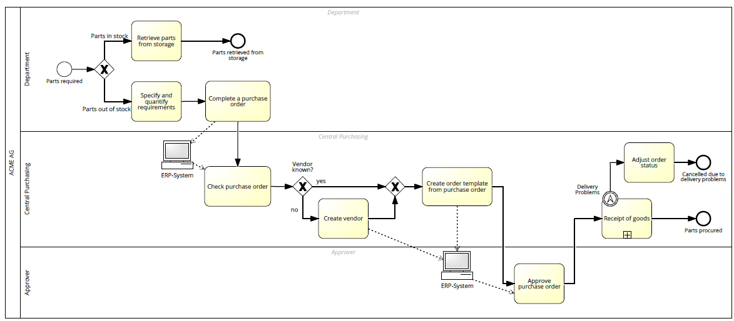


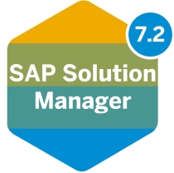
RELY 2.0 Framework integrated with Tools
Auto generation of manual test cases
Automatically upload test cases
Gen-AI TestGenius app
Collect Business Process
Business process maps, workflows
Upload to Test Management Tool
(Import Excel TCs)
Create automated test scripts
Test Planning
Business Process
Test Cases
Pre-Defined Templates and checklists
SolMan
Pre-built manual / automated TCs
Automate Test Cases
Reusable Repository
Juke box of predefined commercialization check lists, templates and other testing artifacts
User Input
Automation DEX, Test management
Test Data Generator
Intelligent Test Execution
Extract & generate test data
LTIM ART (Advanced Reporting Tool)
Test Execution / Defect Management
Impact Based Testing framework
Feedback mechanism
Advanced Reporting Tool
Run Change impact analysis tool - LiveCompare Impact to identify Impacted Test Cases
LTIM Solutions
Notes:
PT need to be added , dedicated slide.
The Worksoft Process Intelligence dashboard uses AI and ML to bring together multi-source, multi-variant data, offering a 360-degree of your end-to-end processes

Slide 12

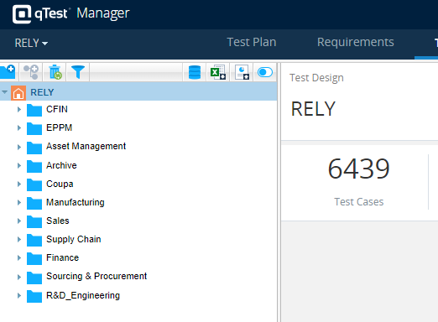
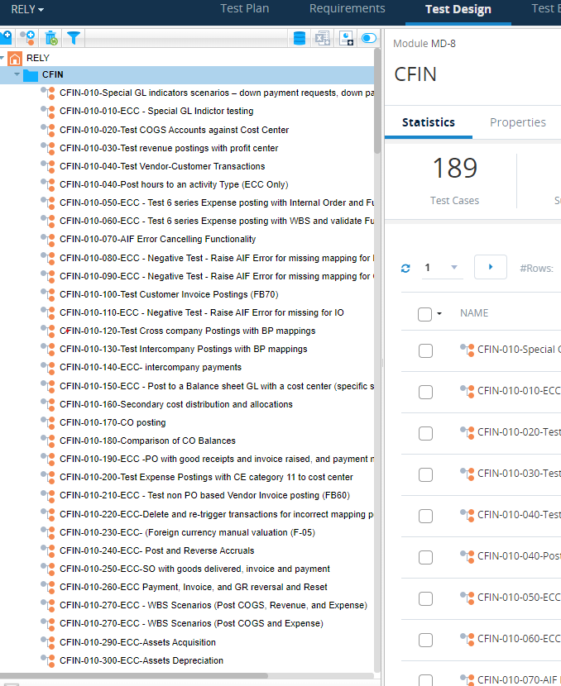
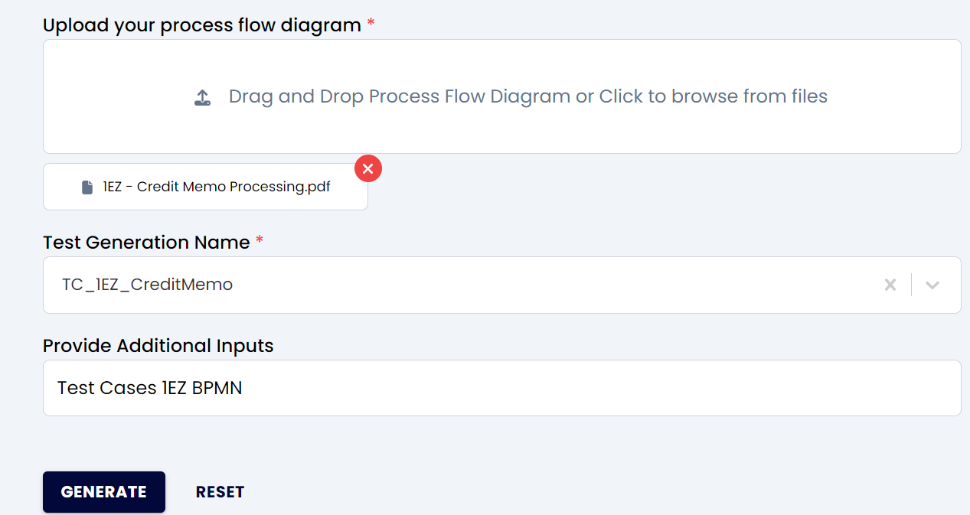
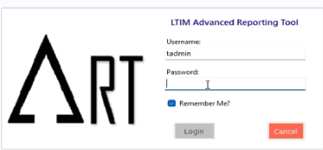



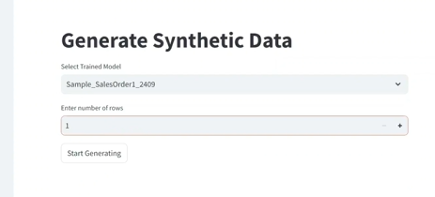

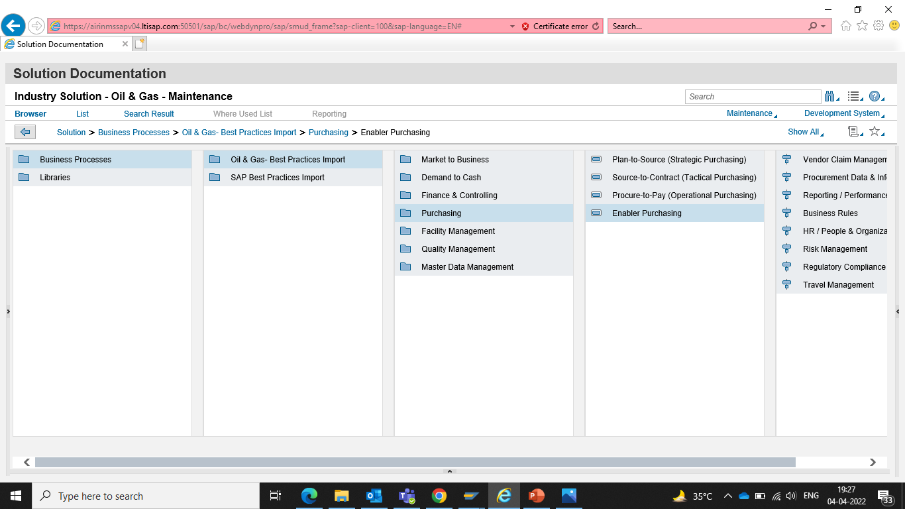
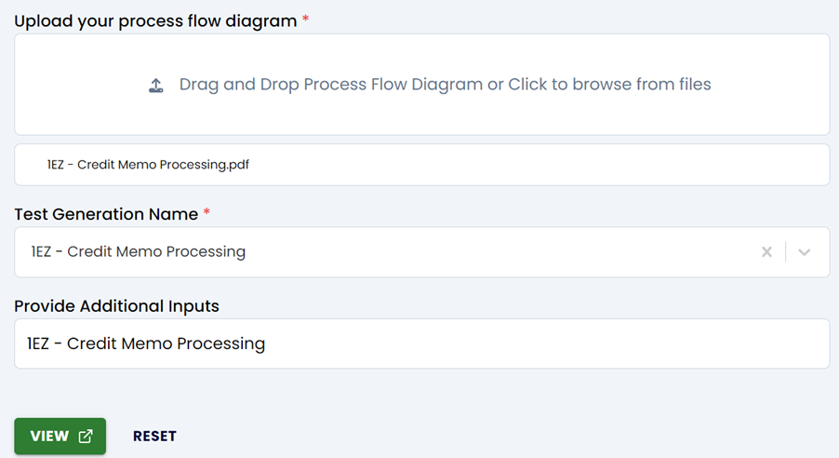
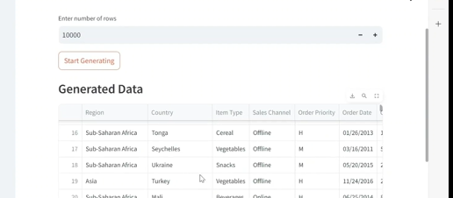
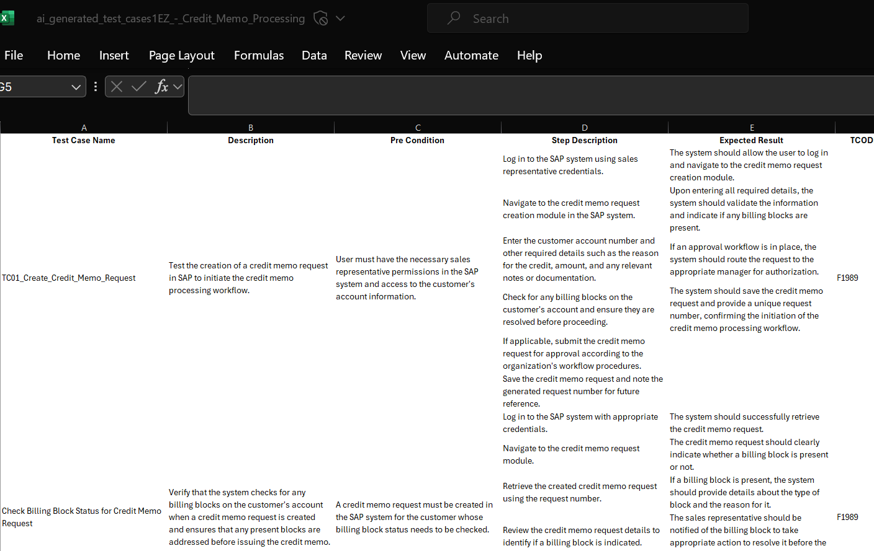
LTIM Gen AI based Accelerators
TestAcademia – Test Library
TestGenius - Test Case Builder
DataFabric - Test Data Generator
ART - Advanced Reporting Tool
TestAcademia
Gen-AI TestGenius App
Test Data Generator
Advanced Reporting Tool
Library of SAP best practice for industry verticals. Reference test scripts available based on industry classification for easy reference
Bundle or Automation scripts available in Tosca, UiPath & Worksoft which are the most widely used automation tools
Component based scripts providing maximum reusability and reduction is generation time.
Continuous updates in Test Case Library enhancing the overall volume
Automates the creation of test cases from SAP business process models and diagrams, saving time and reducing manual effort by providing output in Excel format, ensuring easy integration with various Test Management tools such as ADO.
Supports BPMN from multiple sources, including SAP Signavio, SolMan, and user-designed PDFs, offering flexibility and compatibility.
Efficient validation of SAP Business Processes, enhancing accuracy and consistency in test case generation
UI-based utility simplifies SAP test data extraction and generation, ensuring accurate results tailored to user input and reducing the risk of errors
Transforms complex data management tasks into efficient processes, enhancing productivity by 20% during test execution and empowering users of all technical levels
A comprehensive context menu provides easy data selection.
Advanced Reporting Tool (ART) generates clean, template-based Worksoft Certify Execution reports in PDF format with both summary and detailed views
Easy UI for business users or functional SMEs to generate automation reports without requiring Worksoft Certify installation
PDFs enabled with navigation through hyperlinks, making it simple to move between sections

Slide 13










Proven Outcomes delivered to our Customers with Test Acceleration
Cost Savings Lever
% savings
What we have delivered
Test Automation
30-45% | >40% increase in Productivity >50% decrease in Execution time
55-70% | 10X faster Change Impact analysis50-60% productivity increase with component reuse insights
25-30% | 15% license cost savings with re-platforming >25% license optimization
20-35% | 40% cycle time reduction <1% defect leakage Reduction of 30-60% regression bloat
20-30% | >35% increase in re-usability of assets through templatized strategy ~30% reduction in pre-requisite mgt. efforts
20-35% | >70% improvement in test data quality ~50% Reduced Test data dependencies across test sets
25-40% | >40% effort optimization by leveraging manual & automation standard scripts
20-30% | ~30% Increased Productivity >40% dev. Effort reduction from Early automation, Early detection of defects
Impact based testing
Tools consolidation
Testing COE
LTIM accelerators, Rely platform, GenAI
Test data management
S/4HANA testing accelerators
DevOps Integration
Notes:
Carrier, CPChem, JCI

Slide 14
Case studies

Slide 15


Our Case Studies using Automation
World's largest cosmetics company
Leading Consumer Goods company
US based petrochemical company
Automation
Automation
Automation DI
Testing CoE Setup for SAP
200+ Business workflows automated for regression scope of SAP core solutions
Implementations across US,EMEA,APAC
DevOps Setup with Integration of Automation with and Jenkins
Built a robust & comprehensive automation test suite of 300+ E2E test scenarios
Brownfield scripts can run on both ECC and S/4HANA interface
Performance Testing using NeoLoad
Delivered 1000+ Automated scenarios for E2E Validation & Data Migration testing using Automation Data Integrity tool
E2E Automation test suite covering Test Scenarios of SAP to BW Process triggers upto reports
For Migration to HANA, Selected variety of objects (Table,Cubes,DSO) for Rows & Cols comparison between Oracle & BW/4HANA
Value Delivered
Value Delivered
Value Delivered
Test CoE established framework for Repositories & Processes that leads to 60% faster QA
75% Regression Test coverage
>70% reduction in execution efforts through QA automation
Higher Delivery Confidence & Increased operational efficiency for weekly releases
Achieved over 80% automation test coverage across 4 applications with 300+ E2E Automated Scenarios
80% reduction in Test execution efforts through automation
2700+ hours saved for FPPS-Planning Release
DI Execution is Fast & Accurate for over 800 object comparisons with millions of records
Identified 9 critical defects at early state. Reported 143 discrepancies in data comparison on PROD

Slide 16
Thank You
Let’s get to the future, faster. Together.

